Slide 1
Midterm CSCI 860 – ML
Name:- Himani Parikh
ID#:- 1322085
Data Set:-Sleep Dataset from SC Sleep-EDF Database
Question:-Compare the performance of the 6 different classifiers and which classifier has the best performance with best number of feature?

Slide 2
Objective
Classifier: Naive Bayes, Decision Tree, Random Forest, LDA, QDA, MLP.
10-fold cross validation.
Provide the curve that compares the accuracy of all classifiers vs features.
Provide confusion matrix for the test results for each classifier with best feature.
Which classifier gives best accuracy with less features.
Dataset:
Samples: 2400
Features: 15
Classes: Light sleep + REM, Deep sleep and Awake
Partition:- 80% training and validation, 20% testing

Slide 3
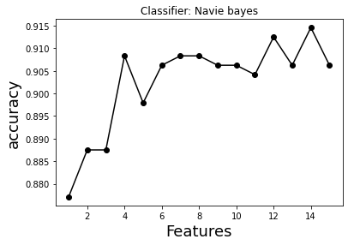
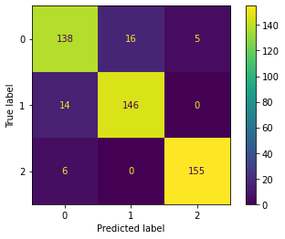
Naïve Bayes
Accuracy | 91.4583
Feature | 1-14

Slide 4
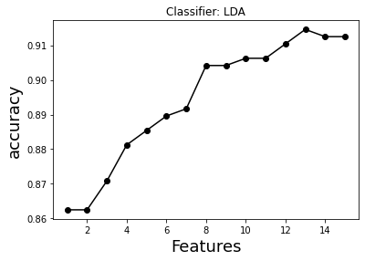
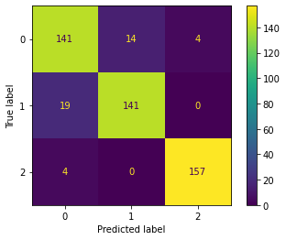
LDA
Accuracy | 91.4583
Feature | 1-13

Slide 5
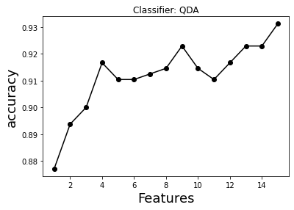
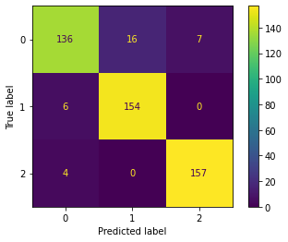
QDA
Accuracy | 93.125
Feature | 1-15

Slide 6
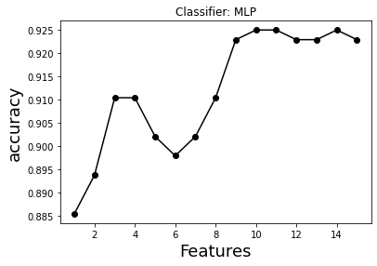
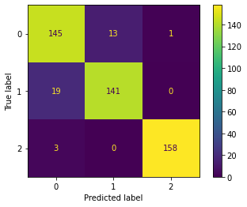
MLP
Layers:-
1:- 128 neurons
2:- 64 neurons
3:- 32 neurons
Accuracy | 92.5
Feature | 1-10

Slide 7
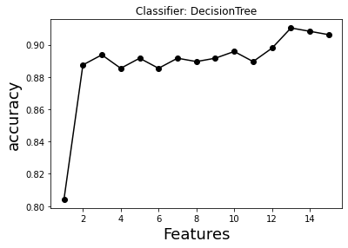
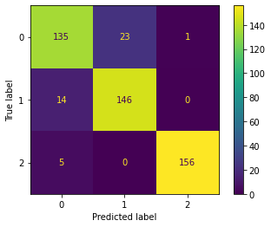
Decision Tree
Accuracy | 91.042
Feature | 1-13

Slide 8
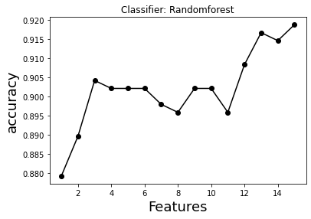

Random Forest
No of Trees | Accuracy | Feature
10 | 91.88 | 1-15
50 | 91.66 | 1-13
100 | 91.66 | 1-12

Slide 9
Precision
Classifiers | Light sleep + REM | Deep sleep | Awake
Naïve Bayes | 87.342 | 90.123 | 96.875
LDA | 85.976 | 90.967 | 97.515
QDA | 93.150 | 90.588 | 95.371
MLP | 86.826 | 91.558 | 99.371
Decision Tree | 87.662 | 94.080 | 99.363
Random Forest | 87.974 | 89.506 | 98.125
*All above values are in percentage

Slide 10
Sensitivity
Classifiers | Light sleep + REM | Deep sleep | Awake
Naïve Bayes | 87.734 | 93.769 | 91.250
LDA | 85.975 | 92.834 | 88.125
QDA | 93.150 | 96.884 | 96.250
MLP | 86.826 | 93.146 | 88.125
Decision Tree | 87.662 | 94.080 | 91.250
Random Forest | 87.974 | 94.080 | 90.625
*All above values are in percentage

Slide 11
Specificity
Classifiers | Light sleep + REM | Deep sleep | Awake
Naïve Bayes | 95.000 | 96.273 | 98.432
LDA | 95.625 | 97.515 | 98.746
QDA | 95.000 | 97.515 | 97.806
MLP | 95.937 | 98.136 | 99.686
Decision Tree | 92.812 | 96.894 | 99.686
Random Forest | 94.687 | 97.515 | 99.059
*All above values are in percentage

Slide 12
F1-Score
Classifiers | Light sleep + REM | Deep sleep | Awake
Naïve Bayes | 87.341 | 90.683 | 96.573
LDA | 85.975 | 89.523 | 97.515
QDA | 93.150 | 93.333 | 96.615
MLP | 86.826 | 89.808 | 98.749
Decision Tree | 87.662 | 88.753 | 98.113
Random Forest | 87.974 | 90.062 | 97.819
*All above values are in percentage

Slide 13
False Positive Rate
Classifiers | Light sleep + REM | Deep sleep | Awake
Naïve Bayes | 6.23 | 5 | 1.56
LDA | 7.16 | 4.37 | 1.25
QDA | 3.11 | 5 | 2.19
MLP | 6.85 | 4.06 | 0.3134
Decision Tree | 5.91 | 7.18 | 0.313
Random Forest | 5.91 | 5.31 | 0.940
*All above values are in percentage

Slide 14
False Negative Rate
Classifiers | Light sleep + REM | Deep sleep | Awake
Naïve Bayes | 1.32 | 8.75 | 3.72
LDA | 1.13 | 1.18 | 2.48
QDA | 1.44 | 3.75 | 2.48
MLP | 8.80 | 1.18 | 1.86
Decision Tree | 1.50 | 8.75 | 3.10
Random Forest | 1.25 | 9.37 | 2.48
*All above values are in percentage

Slide 15
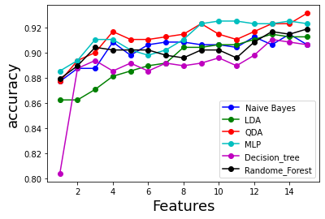
Comparison of all classifier’s accuracy vs number of features used

Slide 16
According to my analysis MLP provides the best outcome with the least number of features used for training and cross validation. Highest accuracy is provided by QDA but with higher features. Random forest also provides great accuracy with less features, but at the cost of higher training time.
Conclusion

Slide 17
Thank you!

